Slide 1
AICS's Senior High Profiles

Slide 2
Functionalities
To input data and information of students in a form of excel.
To see the actual list and information of students.

Slide 3
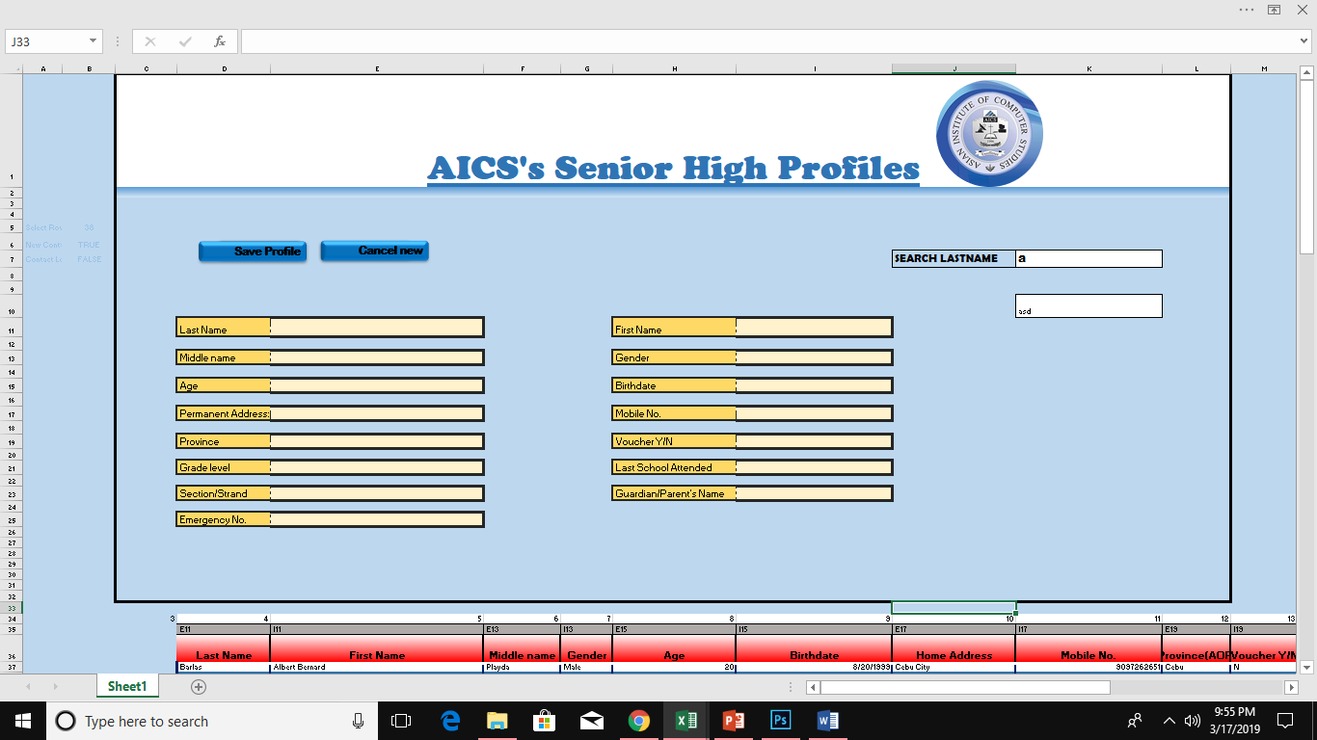
Prototype

Slide 4
